Slide 1
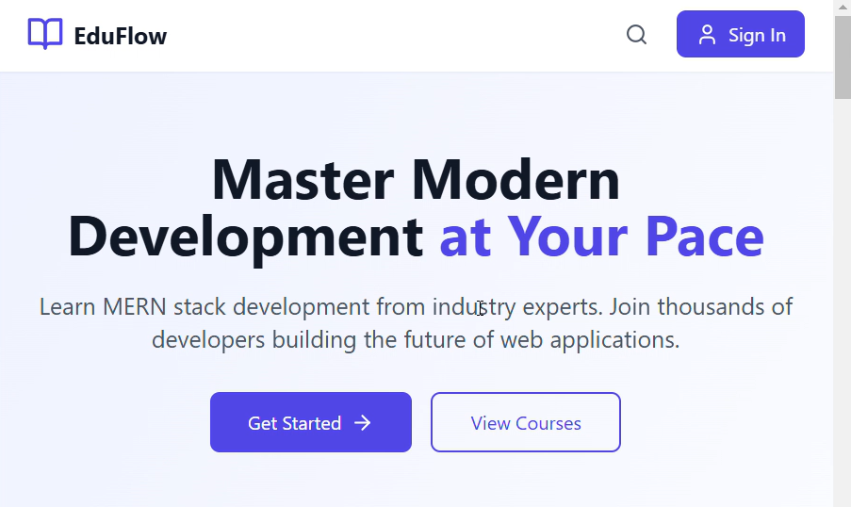
ONLINE LEARNING PLATFORM
Master Modern development at your Pace…
EDU FLOW

Slide 2
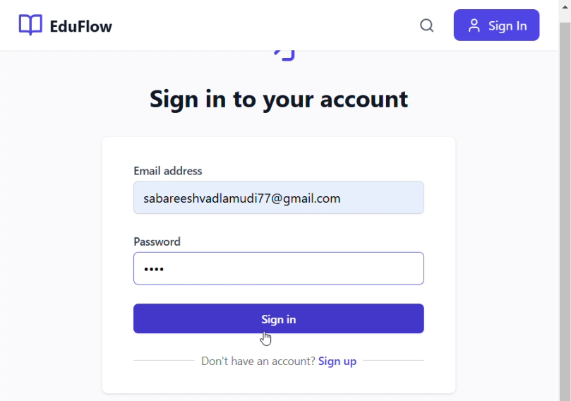
LOGIN/SIGN IN PAGE-
We can login/ sign in into the site by entering our details.

Slide 3
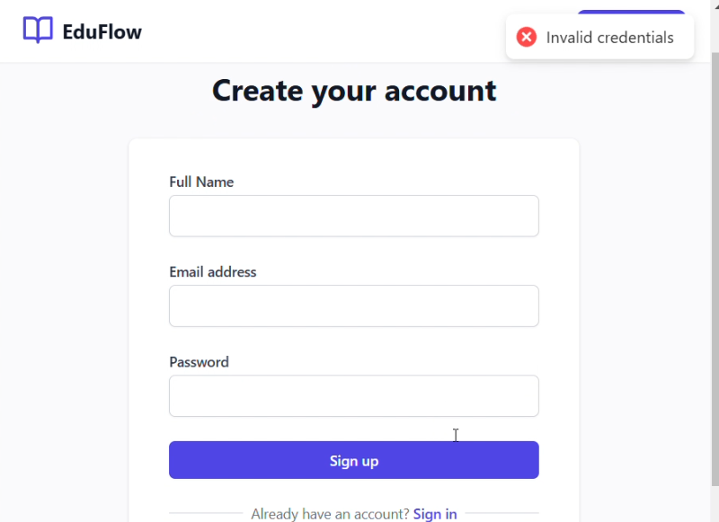
CREATING AN ACCOUNT -
The learner who wants to access the course to study should create an EDU ID

Slide 4
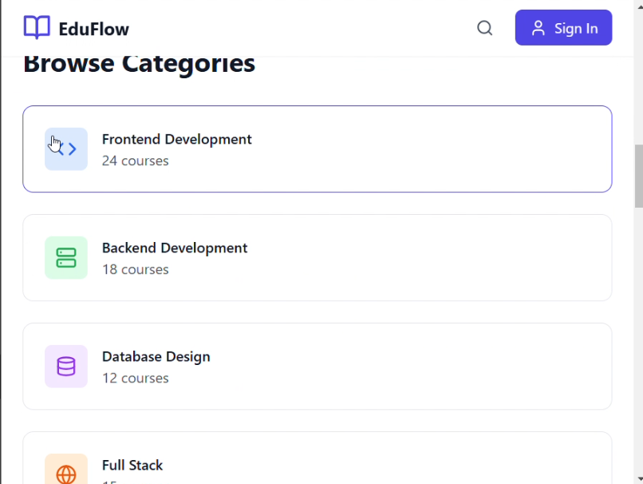
SELECTING THE COURSE -
The learner can select the categories in which he/she wants to pursue the skill

Slide 5
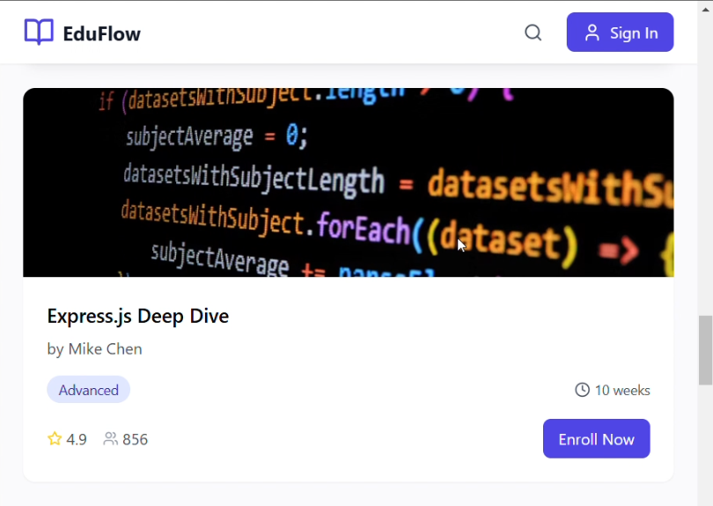
SELECTION OF THE TOPIC -
The learner should even select the topic which they wants to learn. And by clicking the specific topic, they can get videos of their needed content and they can watch it and learn it.

